Slide 1
Introduction to BlueROV and Simulator
34763 Autonomous Marine Robotics Course (Training)

Slide 2
Outlines
Training Activities
About BlueROV
Hardware
Software
BlueROV simulators
UUV simulator (ROS+Gazebo)
Software In The Loop with Pixhawk PX4
Ground control station - Mission planning
This week activities
Setting up simulator (using Docker)
BlueROV teleoperation simulation

Slide 3
Training Activities
Getting started with simulators
Identification of linear models
Path planning 2D and 3D
Controllers tuning (PID)
Pose estimation tuning (EKF)
Neptus for mission planning
To be defined
To be defined
Group assignments (Deployment using real robots)

Slide 4
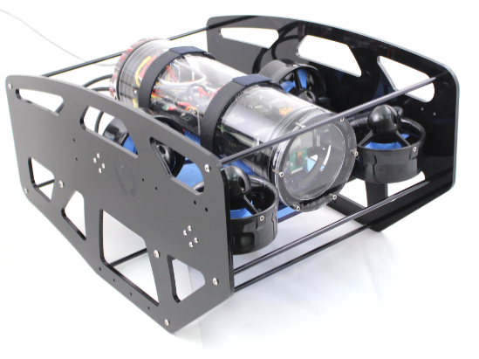
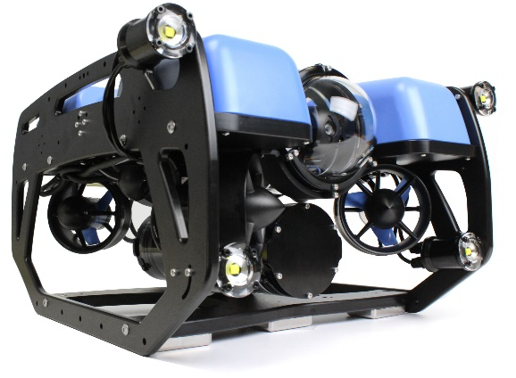
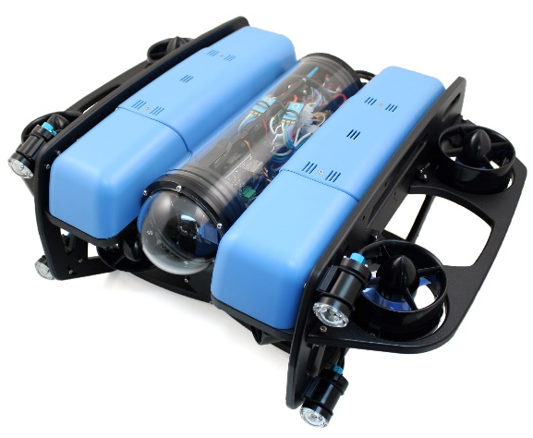
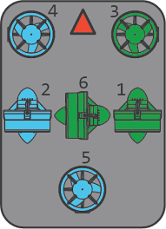
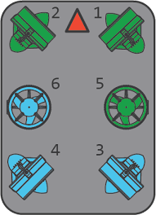
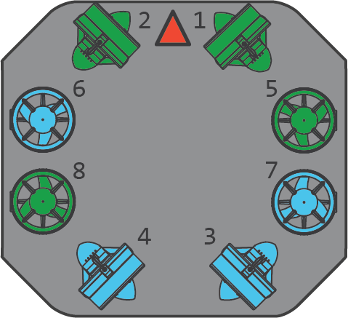
About BlueROV
BlueROV1
BlueROV2
BlueROV2 - Heavy

Slide 5
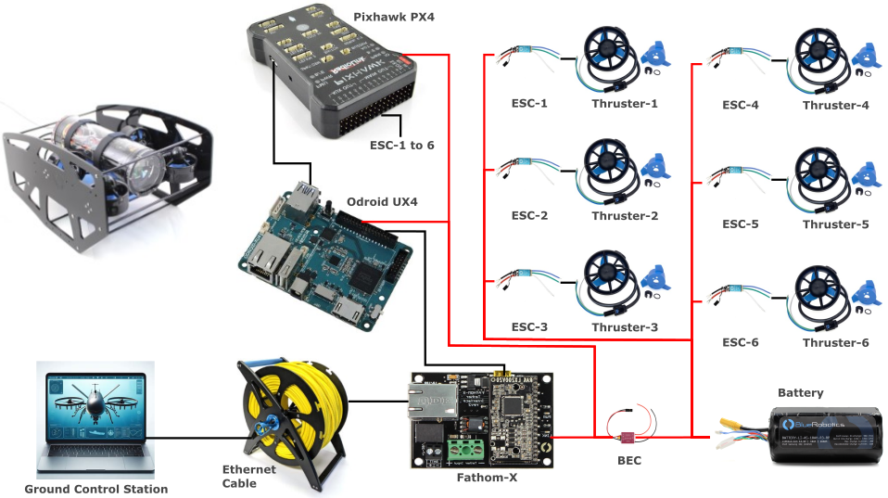
BlueROV Hardware
BlueROV1 (2016)

Slide 6
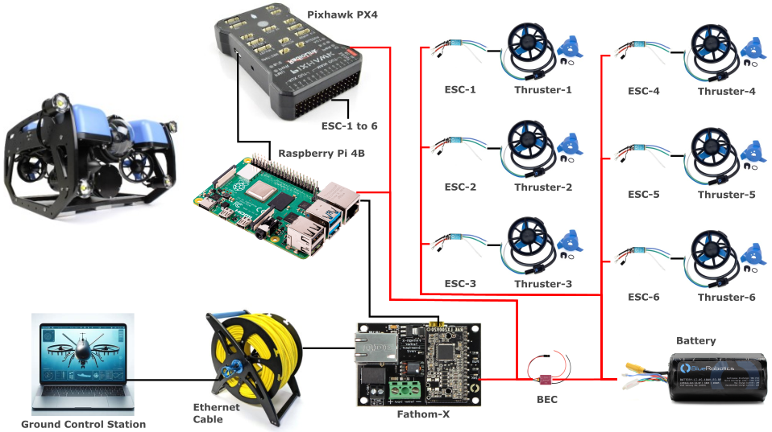
BlueROV Hardware
BlueROV2-R3

Slide 7
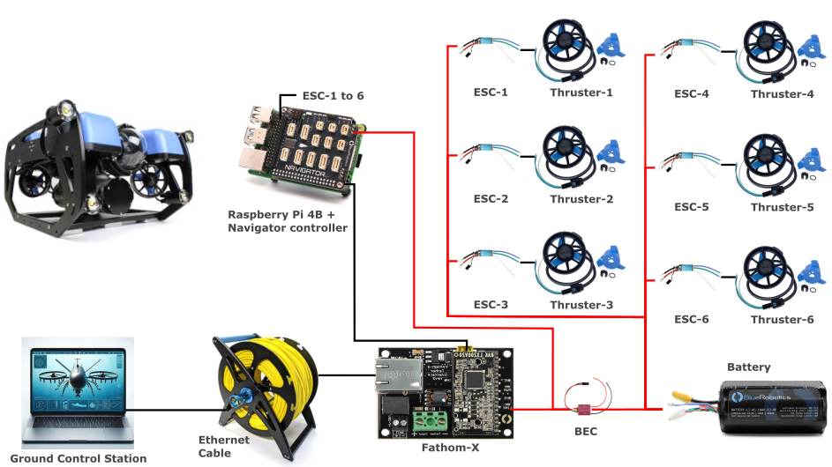
BlueROV Hardware
BlueROV2-R4 (Newest Version)

Slide 8
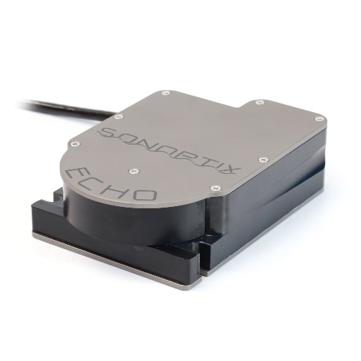
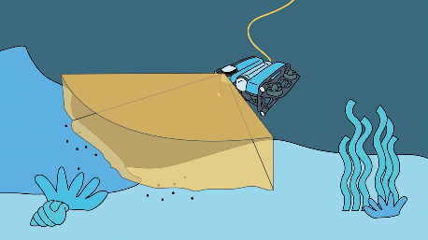
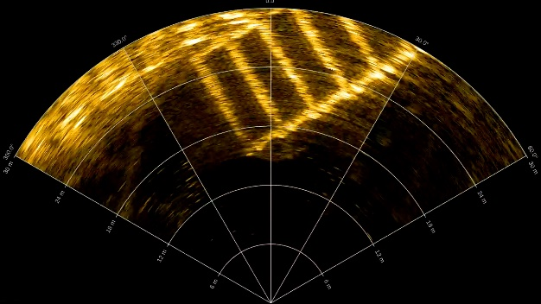
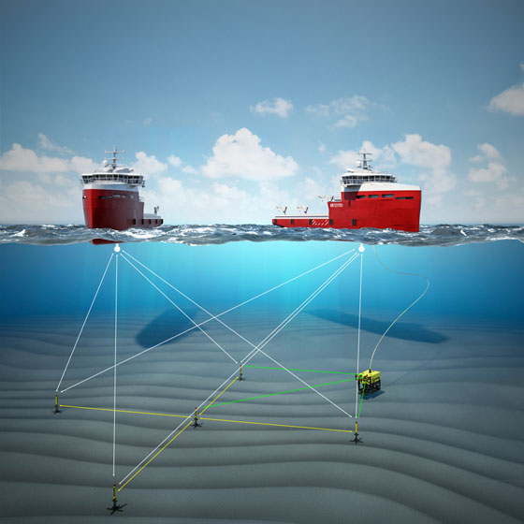
Sensors
Multibeam Imaging Sonar
Sonar:
Ping 1D
Side Scan Sonar
Multibeam Imaging Sonar
Water Linked DVL
IMU (Built-in Pixhawk PX4 and Navigator Controller)
Leak (Built-in Navigator Controller)
Depth/Pressure Sensor
Temperature Sensor
Low-light Camera
External Navigation Aids
HiPAP - Acoustic underwater positioning and navigation systems - Kongsberg Maritime

Slide 9
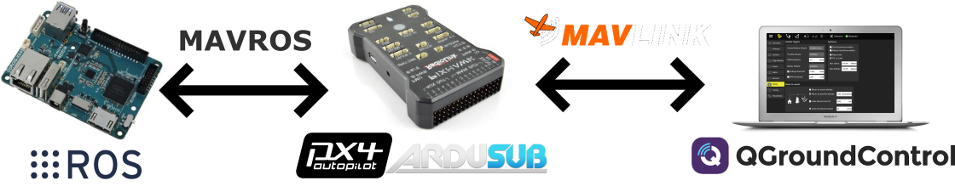
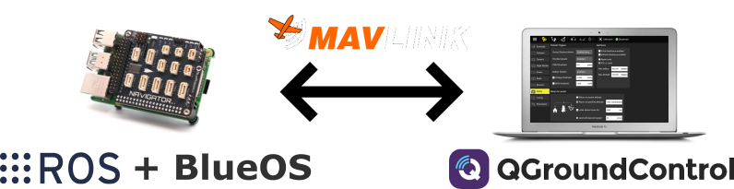
BlueROV Software
BlueROV1 until BlueROV2-R3
BlueROV2-R4

Slide 10
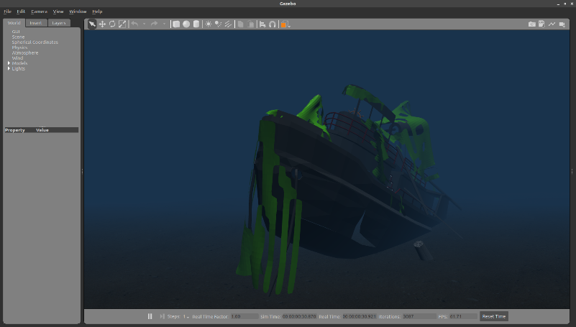
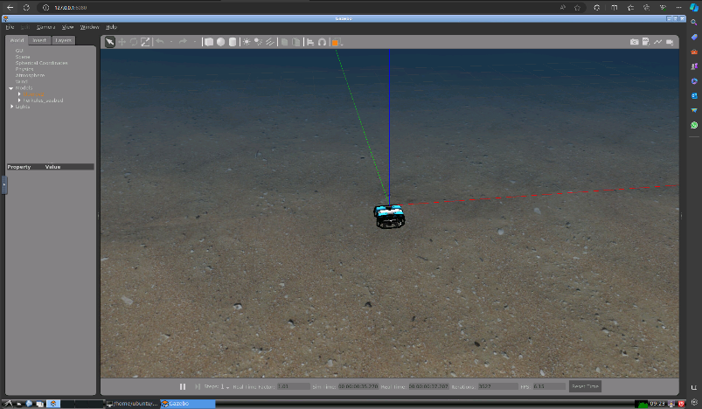
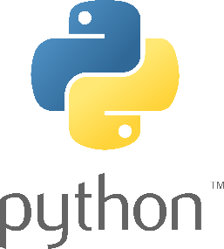
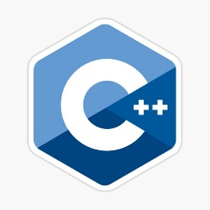
BlueROV Simulators
Gazebo + ROS (UUV Simulator)
Environmental effects: Ocean waves, buoyancy
Sensors:
Camera
Chemical concentration
Sonar
DVL
Low-level control: PID, MPC
Advanced practice: Pose estimation (EKF), SLAM
Programming languages: Python, C++
Furthermore: uuvsimulator.github.io

Slide 11
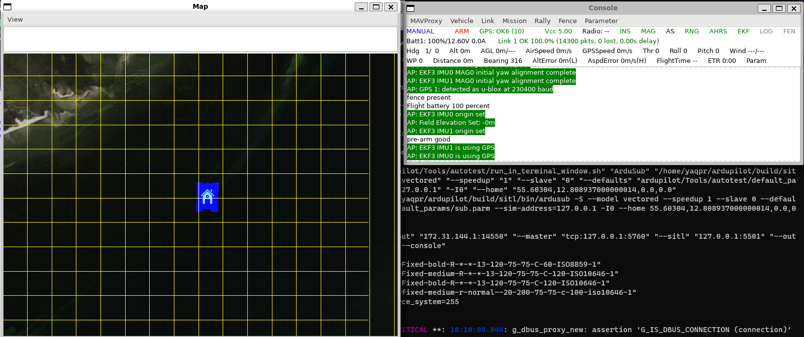
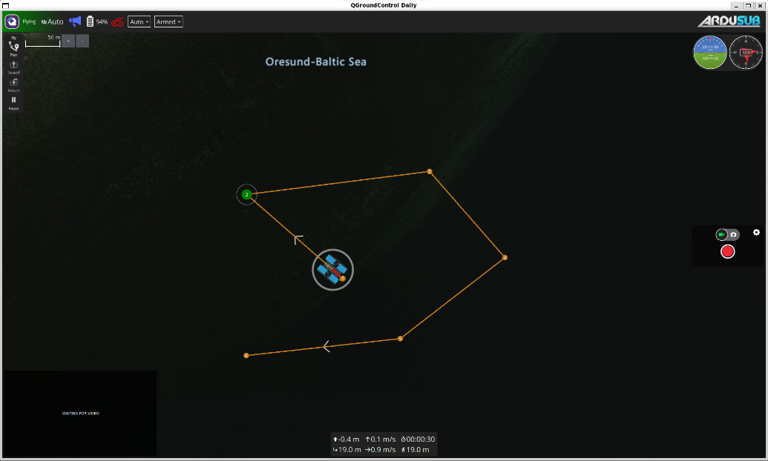
BlueROV Simulators
Software In The Loop Simulation (SITL)
Simple (Ardupilot Sim + QGroundcontrol)
Advanced (Gazebo + ROS + Ardupilot Sim + QGroundcontrol)
Ardupilot Simulator Map and Console
QGroundcontrol

Slide 12
Activities
Getting started with simulators
Docker installation
Build and run docker file
BlueROV2 teleoperation
Visit: https://gitlab.gbar.dtu.dk/dtu-asl/courses/34763-autonomous-marine-robotics

Slide 13
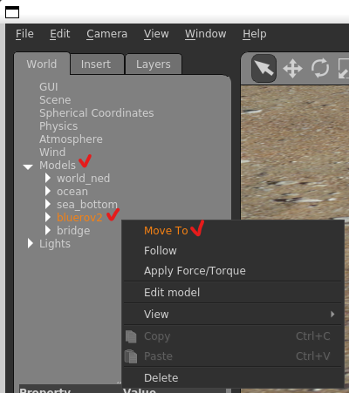
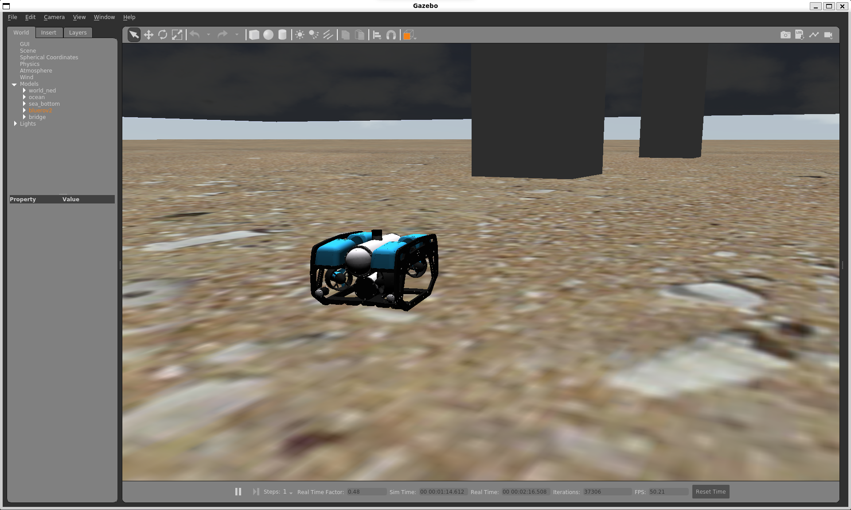
Activities
Open Gazebo and spawn the robot:
roslaunch bluerov2_gazebo start_pid_demo.launch

Slide 14
Activities
Inspect all ROS nodes and topics:
rosnode list
rosnode info <node_name>
rostopic list
rostopic echo <topic_name>
rosrun rqt_graph rqt_graph
rosrun rqt_plot rqt_plot
Inspect ROS tf (transformation):
rosrun rqt_tf_tree rqt_tf_tree

Slide 15
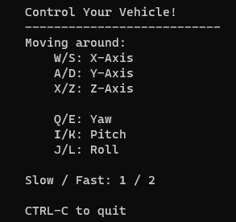
Activities
Make the robot moves!
Using keyboard:
roslaunch uuv_teleop uuv_keyboard_teleop.launch uuv_name:=bluerov2
Using RQT publisher:
rosrun rqt_publisher rqt_publisher
Add bluerov2/cmd_vel, change the value of linear-x to 0.5 to 1, check the checkbox to publish
Using python script as a ROS node to publish bluerov2/cmd_vel value

Slide 16
Activities
Further reading on ROS:

